Slide 1
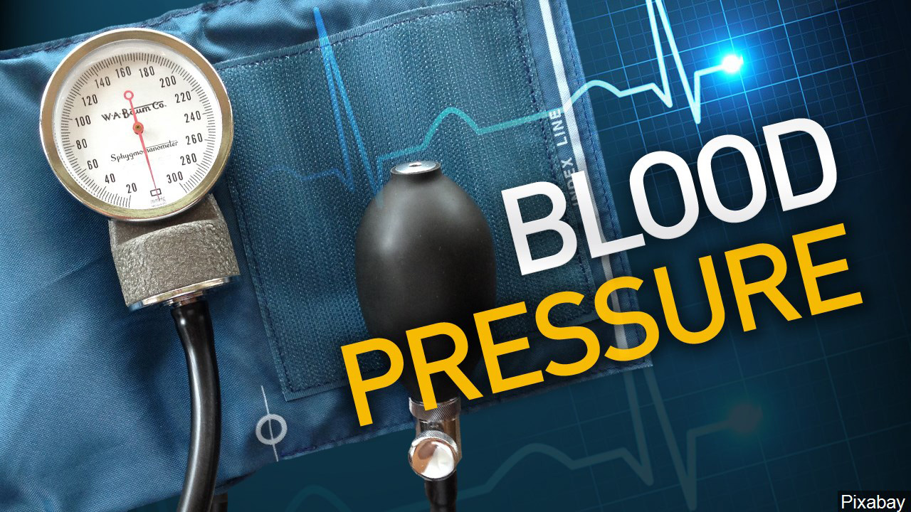
Blood Pressure Predictor
Based on certain details like weight, age,
glucose level, Cholesterol level, pre-existing
conditions, etc. it predicts if you are prone
to high blood pressure or not.
We train the data set using machine learning to predict high blood pressure.
Team
Lorna Migiro
Bernice Ndungu

